Slide 1
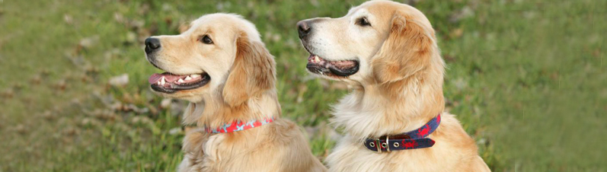
Edge Smart Collar
by Edgy Echidnas
Steven Baum, Andrew Blum, Garrett Fidalgo, Anna Goodman, Eric Quach

Slide 2
Target Group
Dog owners who:
Own medium-to-large dogs
Spend a significant amount of time away from home.
Care about what their dogs are doing.
Trying to improve dog’s behavior

Slide 3
Motivation
Dog owners want to know what their dogs are doing while they are away.
Dog owners want to locate their dogs at any time.
Dog owners want to train their dogs, even while they are away.
→ Camera
→ Log
→ GPS
→ Light
→ Speaker
→ Vibrate
Notes:
Benefits and the relevant hardware
Whats dog up to ?
User misses dog
Additional, new, Interactions with dog
Helps in training dog
Pet health management (tracking activity, eating)
Where is dog ?
Dog runs away from home
Able to not use a leash without worry, such as hikes or camping
- Light on collar for high visibility, at a park
Training your dog
View/track dogs behavior
Get alerts about dog behavior
Speak to dog
Vibrate function
Great benefits to the user as most of this is currently very hard or impossible!

Slide 4
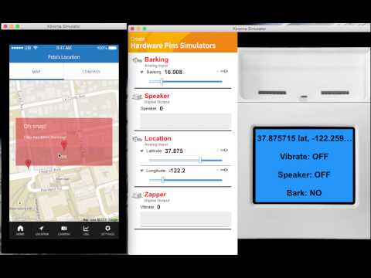
Demo Video
Notes:
APP
Here is our app, and the collar simulator on the right
Lets go along the bottom ribbon of buttons in order
First, our home screen with log, location, and a photo of your dog
Next we have location where we can see a detailed location of dog plus us
The collar has decreed barking and sent an alert to the app
Lets go to the camera screen
Here we can
- view a live video feed
vibrate collar
speak thru collar
turn on the collar light
and save a video still
Next is the Log where we can see activity levels and other recorded metrics
Finally, a simple, clean settings page

Slide 5
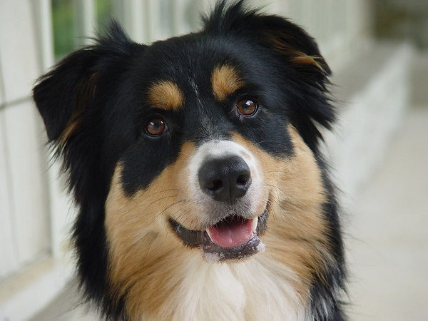
Insights and Changes
Intersection between observation and training
Training, not discipline (buzz, not zap)
The fewer clicks, the better
Implementing unsupported APIs, Google Maps
Notes:
Collar provides both observation, interaction and training
Take aways from users:
People reacted very strongly to shock collar feature!
Train, not discipline (we love our pets!)
Take away about UI:
Less clicks means a better UI
Most difficult challenge of creation:
implementing unsupported API, google maps

Slide 6
Questions?

